Slide 1

Empowering Photography Learning: An AI- Driven Framework for Your Virtual Instructor

Slide 2

Introduction to AI in
Photography
In this presentation, we explore AI- driven frameworks that enhance photography learning. Understanding how artiﬁcial intelligence can serve as a virtual instructor will empower photographers at all levels to improve
their skills and creativity.

Slide 3
The Role of AI in Education
AI plays a pivotal role in personalizing learning experiences. By analyzing individual progress, it can provide tailored feedback and resources, making the learning process more engaging and effective for aspiring photographers.

Slide 4

Understanding Photography Basics
Before diving into advanced techniques, it's crucial to grasp the fundamentals of photography. This includes concepts like exposure, composition, and lighting, which form the foundation for all successful photography.

Slide 5

AI-Powered Learning Tools
Utilizing AI-powered tools can enhance the learning experience. These tools can analyze your photos, suggest improvements, and even simulate different lighting conditions to help you understand various techniques.

Slide 6

Background of the Study
Perfect Frame reshapes the way you pose for photoshoots with its recommendation system. Whether it's a solo portrait, a couple's snapshot, or a selfie, Perfect Frame helps you find the perfect pose effortlessly. Say goodbye to guesswork and hello to picture-perfect moments with Perfect Frame.
Objective
The objective of my project is to provide users with personalized pose recommendations for their photoshoots, helping them capture perfect moments effortlessly.
Perfect framework to fit into any photoshoot scenario, ensuring users capture their desired moments flawlessly.

Slide 7

Virtual Instructors: How They Work
Virtual instructors utilize machine learning algorithms to assess your work and provide feedback. This allows for a more interactive learning experience, where you can learn at your own pace and convenience.

Slide 8
Work Flow Diagram
A Survey of Similarity Measures in Web Image Search
Effortlessly Recommending Similar Images
+++
Pros:-
1. Offers a comprehensive overview of image similarity measures
2. Provides insights into strengths of different measures.
3.Helps in understanding theoretical foundations of image similarity.
+++
Proposing an enhanced solution leveraging visual feature prioritization, practical implementation with pre-trained models, real-world application across diverse domains, and customizable feature extraction and recommendation algorithms using the perfect frame model.
Pros:-
1. Focuses on visual features for image recommendation.
2. Includes practical implementation using pre-trained models.
3. Addresses real-world application in various domains.
Cons :-
1. The limited scope in addressing specific challenges or emerging trends in image recommendation systems.
2.Time taking
3.. Implementation details may be lacking, particularly for real-world application.
4.. Theoretical focus may not address practical challenges in image recommendation.

Slide 9

Enhancing Creativity with AI
AI can stimulate creativity by suggesting unique angles, compositions, and styles. By analyzing existing works, it can inspire photographers to experiment and push their creative boundaries.

Slide 10

Feedback and Improvement
Receiving constructive feedback is vital for growth. AI tools can provide detailed analysis of your work, highlighting strengths and areas for improvement, helping you to reﬁne your skills over time.

Slide 11

Building a Photography
Community
AI can help in creating a supportive community of photographers. Through online platforms, users can share their work, receive feedback, and collaborate, fostering a sense of belonging and motivation.

Slide 12

Ethics of AI in Photography
As we embrace AI in photography, it's essential to consider the ethical implications. Issues like copyright, authenticity, and the role of human creativity must be addressed to ensure responsible use.

Slide 13

Future Trends in Photography Learning
The future of photography learning is bright with AI advancements. Expect more sophisticated tools, immersive experiences, and community-driven platforms that will continue to evolve the way we learn photography.

Slide 14
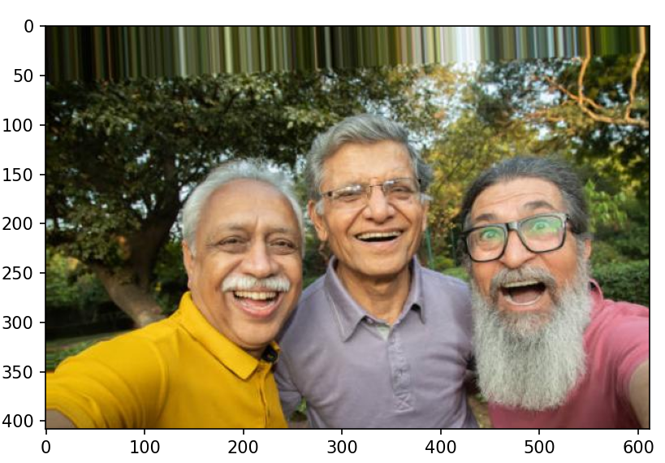
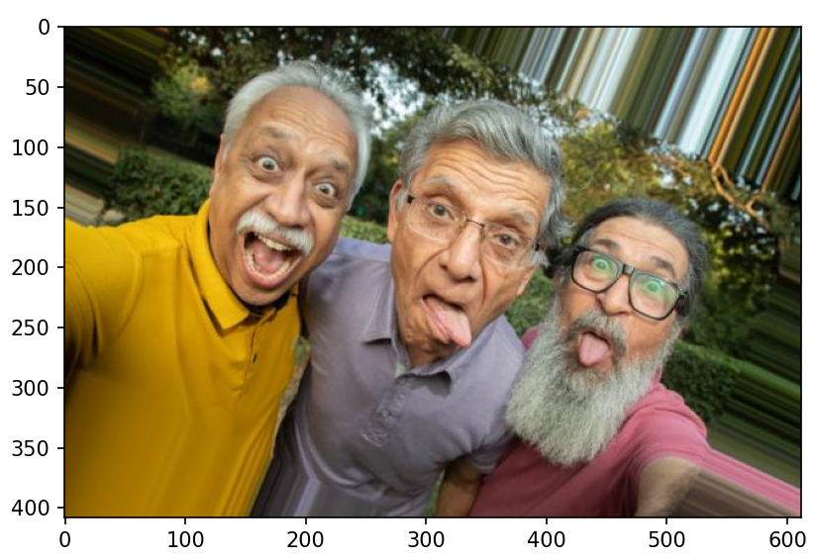
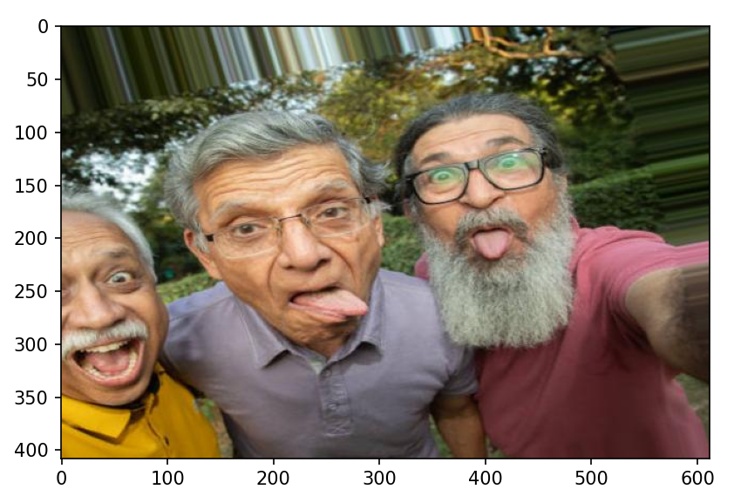
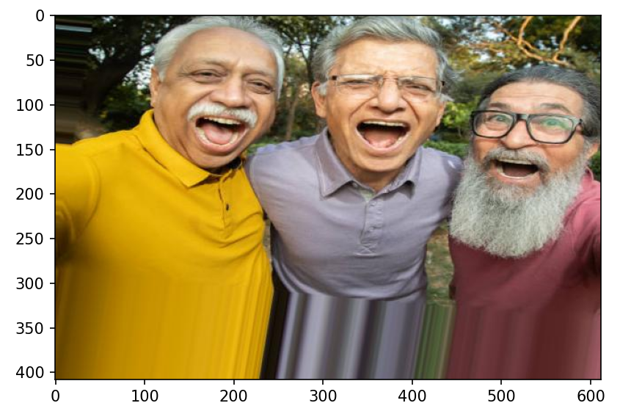
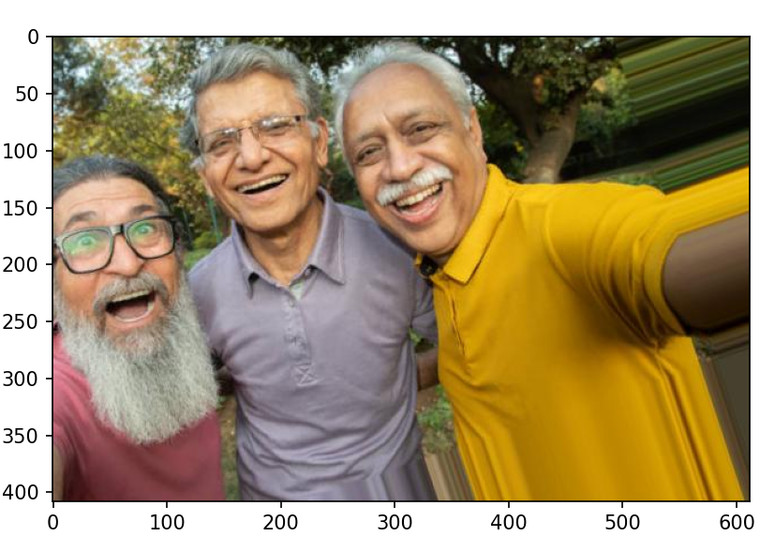
Results Obtained

Slide 15
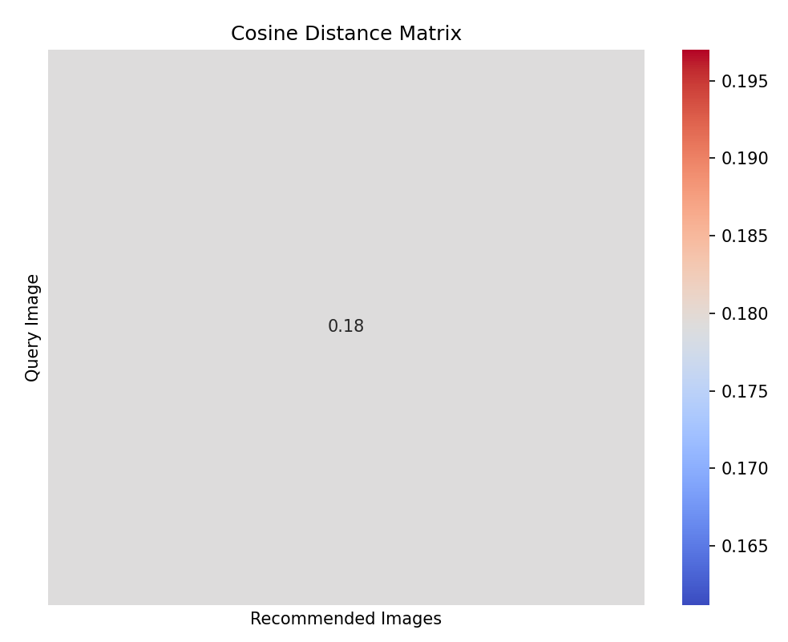
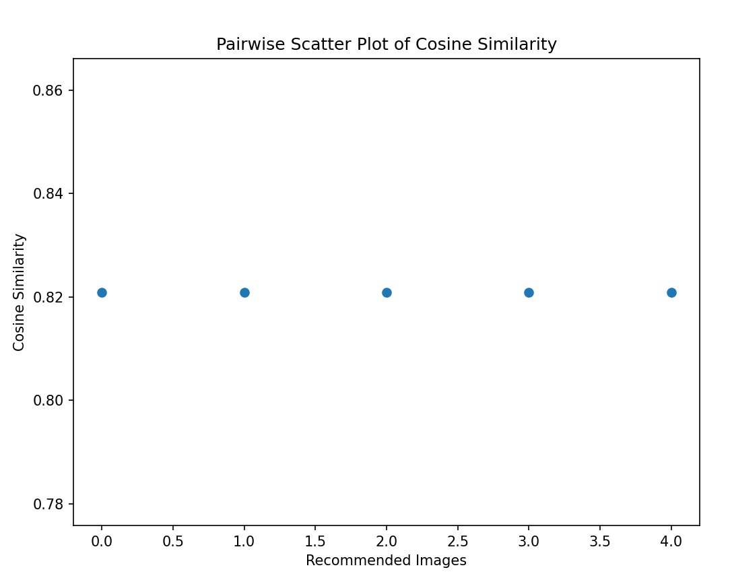
Results Obtained

Slide 16

References
[1] . Yossra H. Ali 1 , Wathiq N. Abdullah2 ,
“A Survey of Similarity Measures in Web Image Search “ University of Technology, Computer Sciences, Department, Sinaa'a Street, Baghdad, Iraq .
[2]. Wan-Yu Chen, Jia-Lin Chen, and Liang-Gee Chen, Fellow
“On-the-fly Fashion Photograph Recommendation System with 1 Robust Face Shape Features “ IEEE DSP/IC Design Lab., Graduate Institute of Electronics Engineering, National Taiwan University, Taipei, Taiwan
[3]. Maciej D. Korzec
“Effortlessly Recommending Similar Images: Using features from pretrained convolutional neural networks to generate comparability”
(https://towardsdatascience.com/effortlessly-recommending-similar-images-b65aff6aabfb)
[4]. Avinash Sooriyarachchi
“Building a Similarity-based Image Recommendation System fore-Commerce “
(https://www.databricks.com/blog/2022/03/01/building-a-similarity-based-image-recommendation-system-for-e-commerce.html)
[5]. Sourav Kumar Goyal
“Similar Images Recommendation Using Keras” (https://www.kaggle.com/code/souravkgoyal/similar-images-recommendation-using-keras-annoy)

Slide 17
Project Timeline
JULY
AUG
SEPT
OCT
Phase 1
Topic selection
Phase 1
Research and Consultancy
Phase 1
Data Collection
Phase 1
Codding and Devlopment
Phase 1
Project Submission

Slide 18
Conclusion: Empower Your Learning
In conclusion, leveraging AI technology in photography education can signiﬁcantly enhance your learning journey.
Embrace these tools and techniques to unlock your full potential as a photographer.

Slide 19

Thanks!

